Slide 1


Slide 2
Disclaimer
All non-public information in this presentation is FINANCIALFORCE CONFIDENTIAL. This presentation and related discussions may refer to planned or proposed products, services, features or functions. Any unreleased products, services, features or functions mentioned in this or other presentations, press releases or public statements are not currently available and may not be delivered on time or at all. Customers who purchase our products or services should base those purchase decisions on features and functions that are currently available. FinancialForce assumes no obligation and does not intend to update any statements about future products, services, features or functions.

Slide 3

Part 1
Pattern Libraries

Slide 4
Intro to Pattern Libraries
Why?
As we are moving forward with our design process and alignment with LEX we (UX) want to create both a consistent process for application of our design components. Including, the conversion of old pages and applications and the design of all new components, apps, and pages.
How?
We will do this by aligning the processes and applications we use to implement our designs across all of our teams and products.

Slide 5
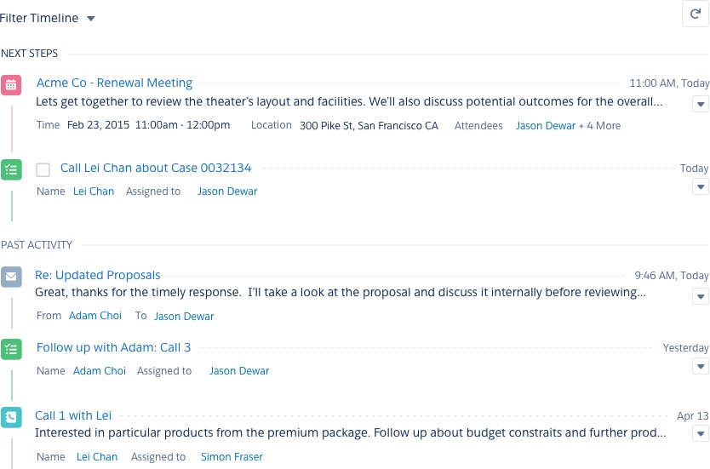
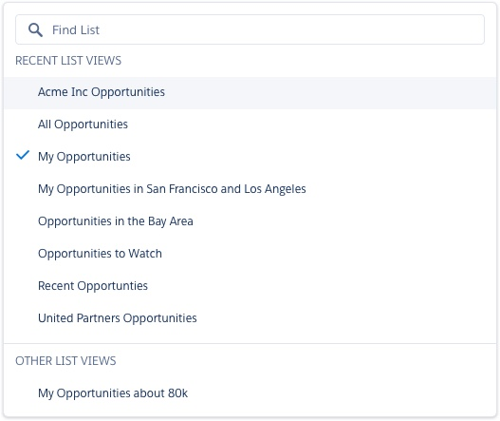
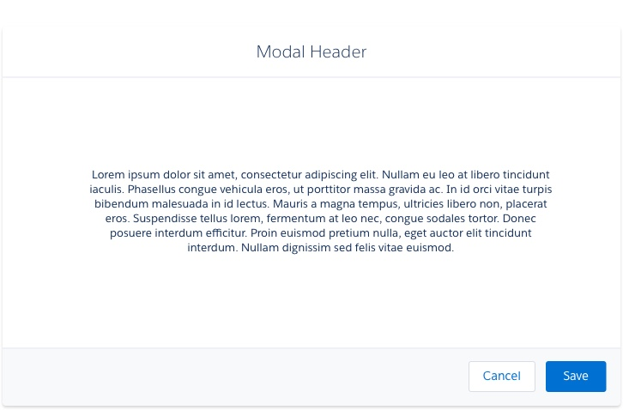
What’s in our Design System Library
Page templates and reusable design patterns all of our components: navigation, grid patterns, forms, controls, search, filtering, imagery, and iconography that will aid us in consistency in our efforts and our user experience. Download Sketch file (v2)
Download Package (v2)

Slide 6
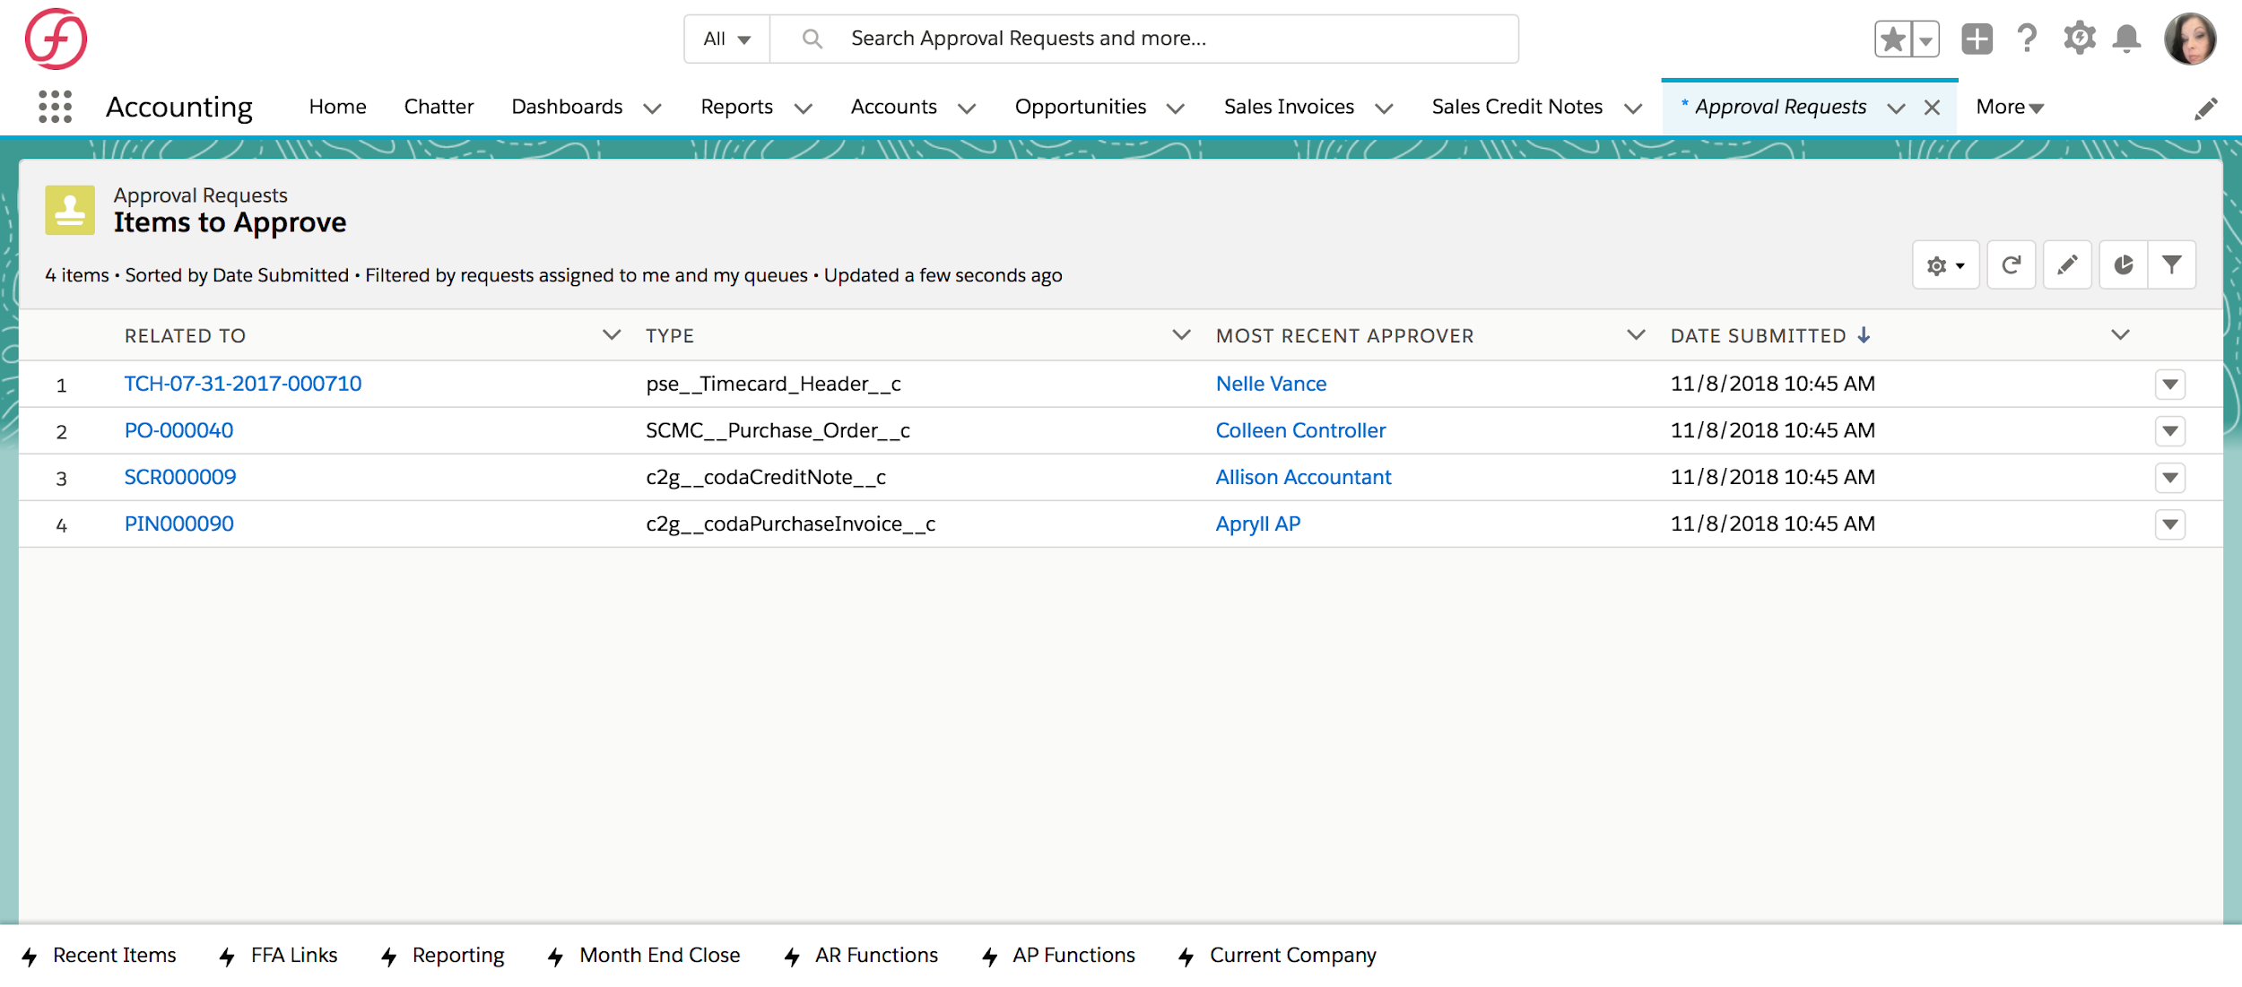
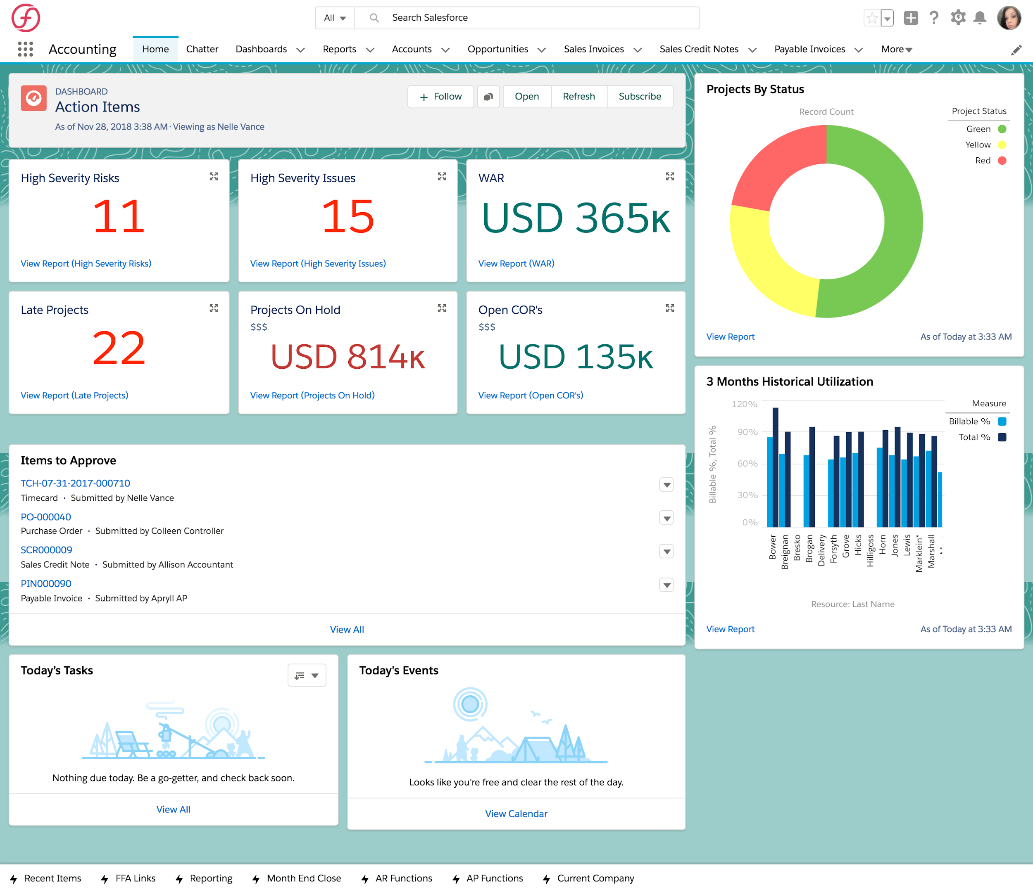
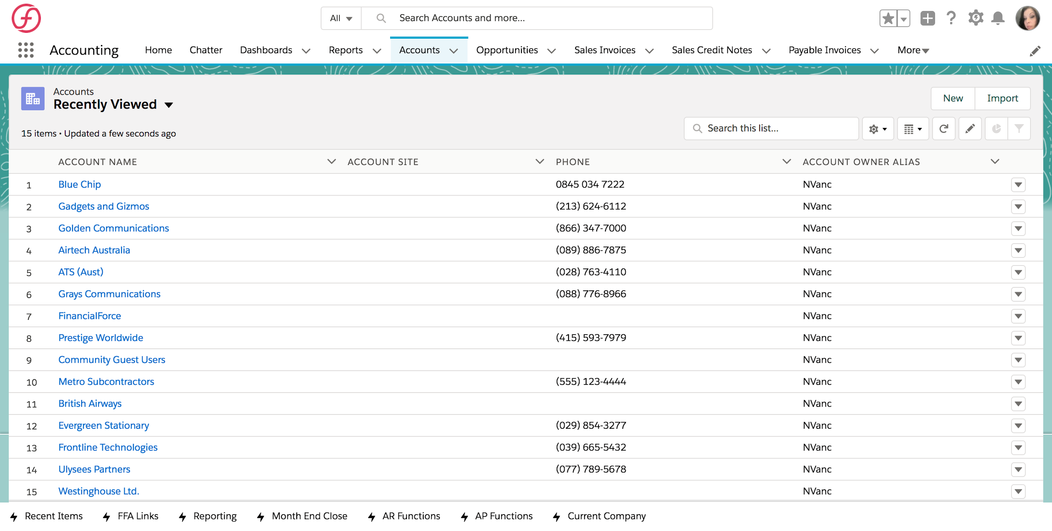
SLDS Page Gallery
Notes:
Download preview files (JPG) - Download
Source files (templates and assets to build new pages) are accessible within the Sketch master file

Slide 7
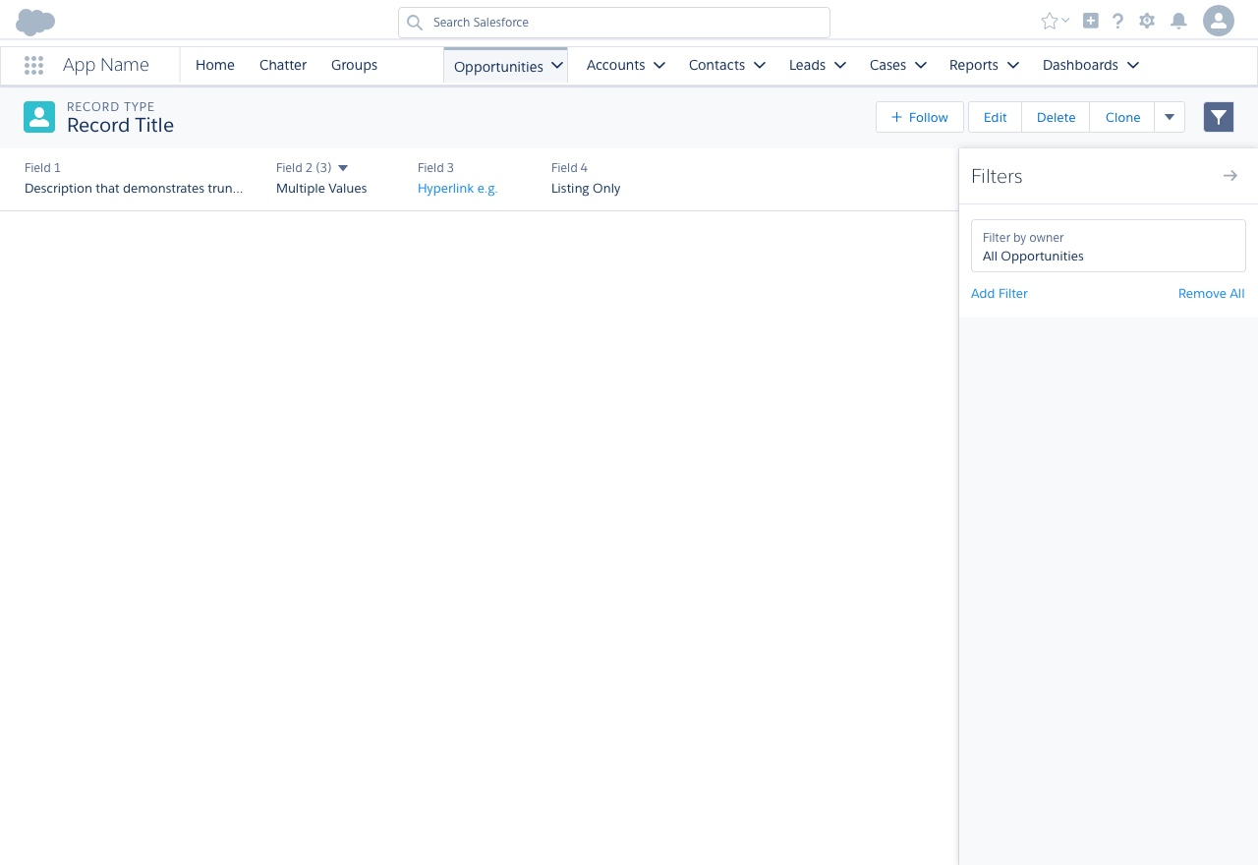
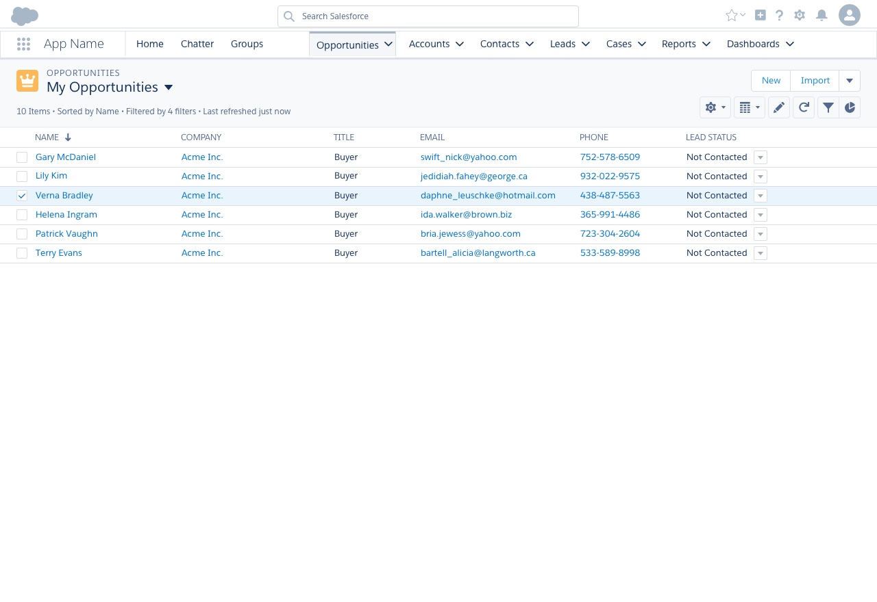
VF & LEX Page Templates
Notes:
Download preview files (JPG) - Download
Source files (templates and assets to build new pages are accessible in the Sketch master file

Slide 8
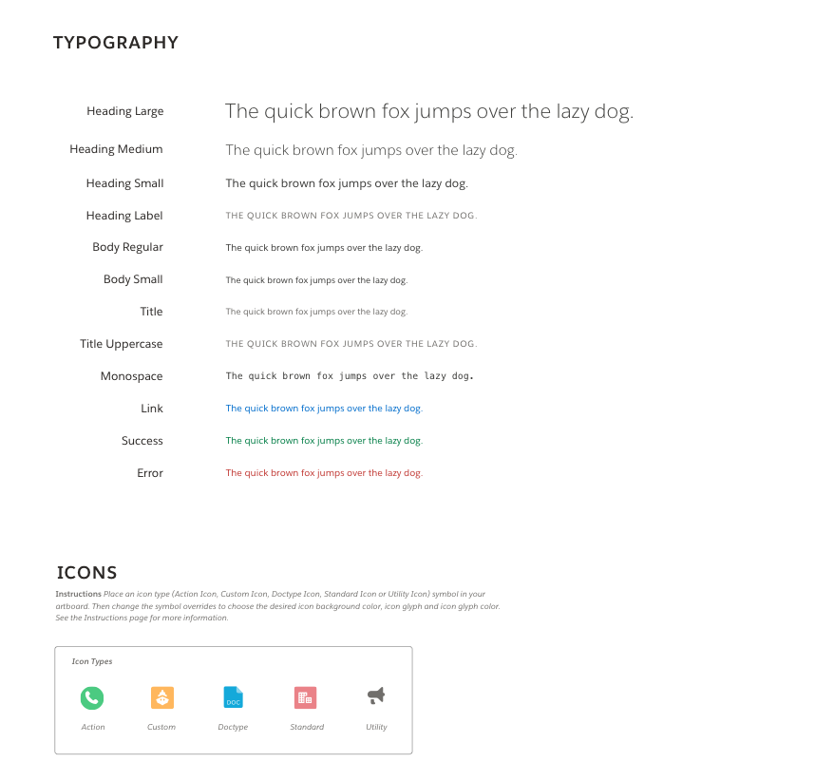
SLDS Imagery & Fonts
Download Icons
Icons
Download Imagery
Imagery
Download Fonts
Desktop Fonts
Web Fonts
Notes:
Individual files links for download in slide

Slide 9
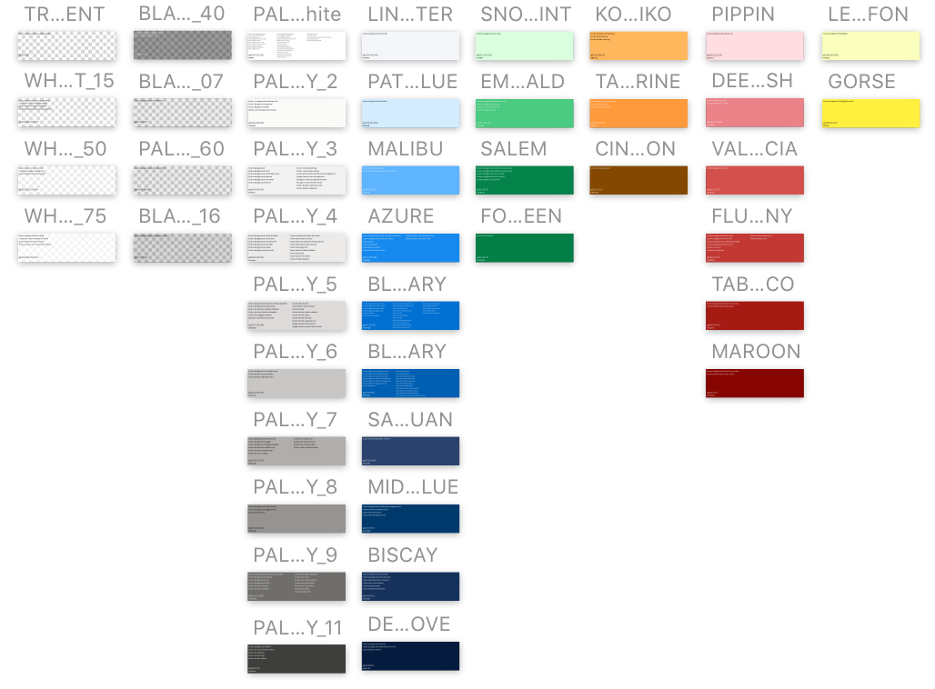
SLDS Color Tokens
Notes:
Download Color Tokens - Download
Download Color Token Exports - Download

Slide 10
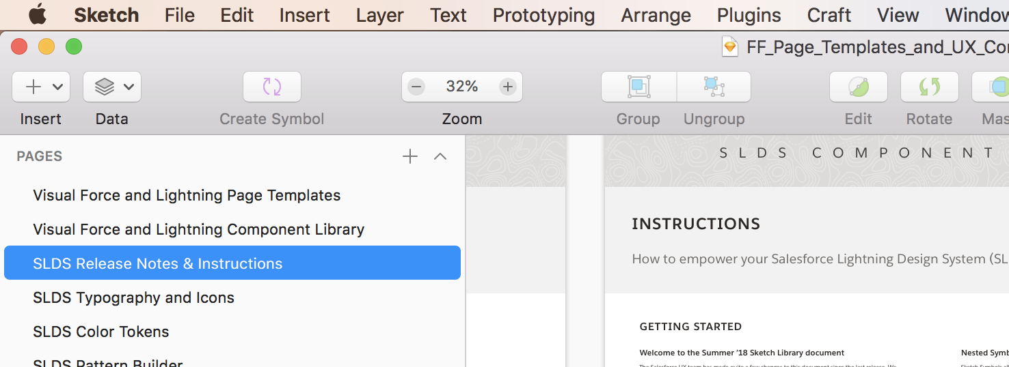
SLDS Resources
The Salesforce UX team has made quite a few changes to this document since the last release. They have made optimizations so you can more efficiently create Salesforce Lightning interfaces. Please refer to the Salesforce UX documentation in the pages tab of our FF Page Templates and component library.
Note: The Salesforce UX team believes this file is best used as a Sketch Library. Our Pattern Library for all of our components are setup for use as Sketch Libraries.
Notes:
Download Release Notes - Download
Download Instructions for Usage - Download
Download Licenses - Download

Slide 11
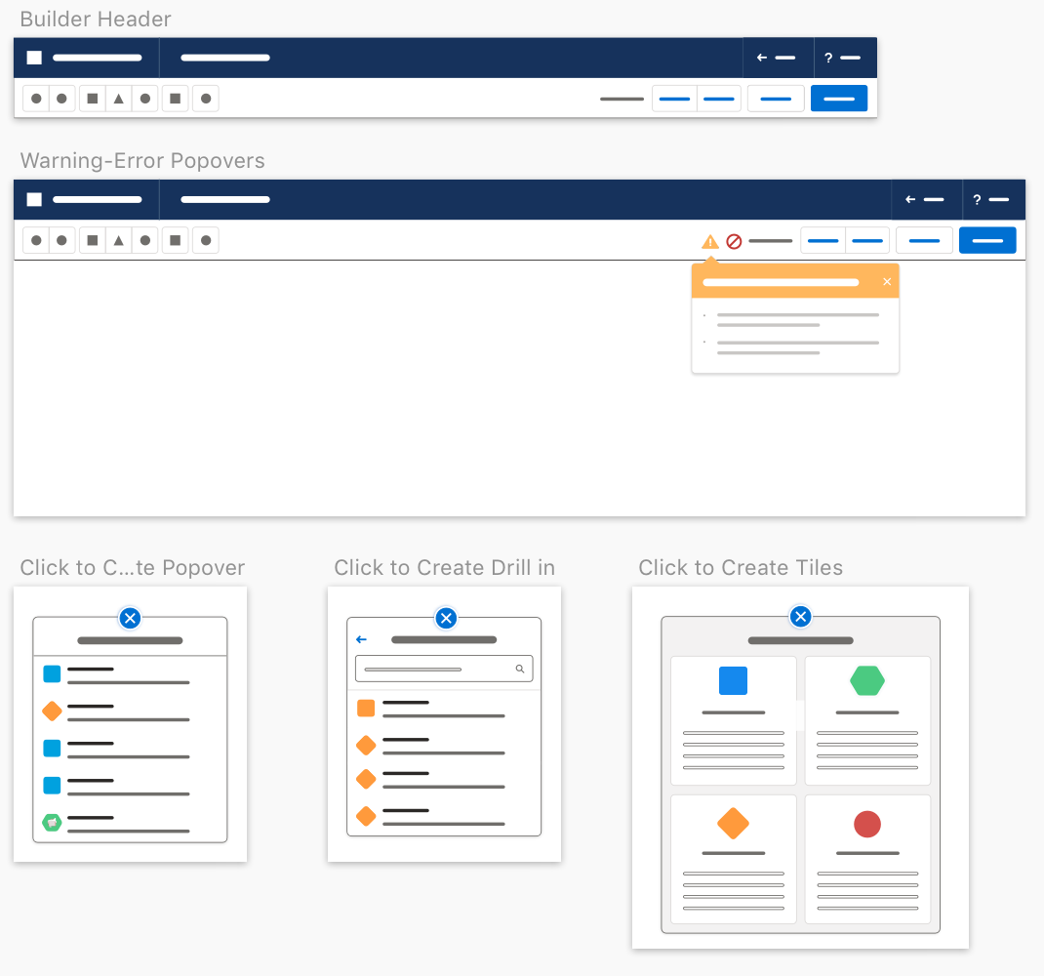
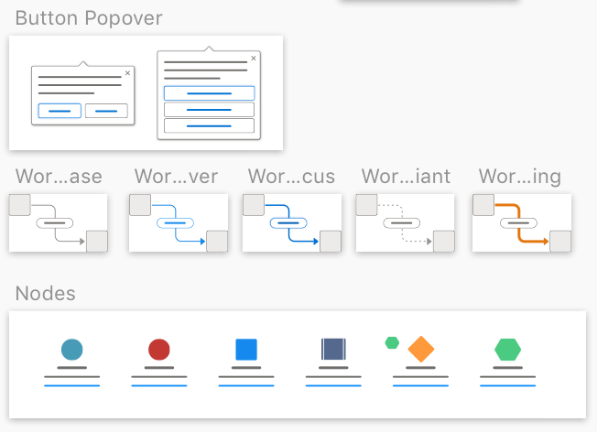
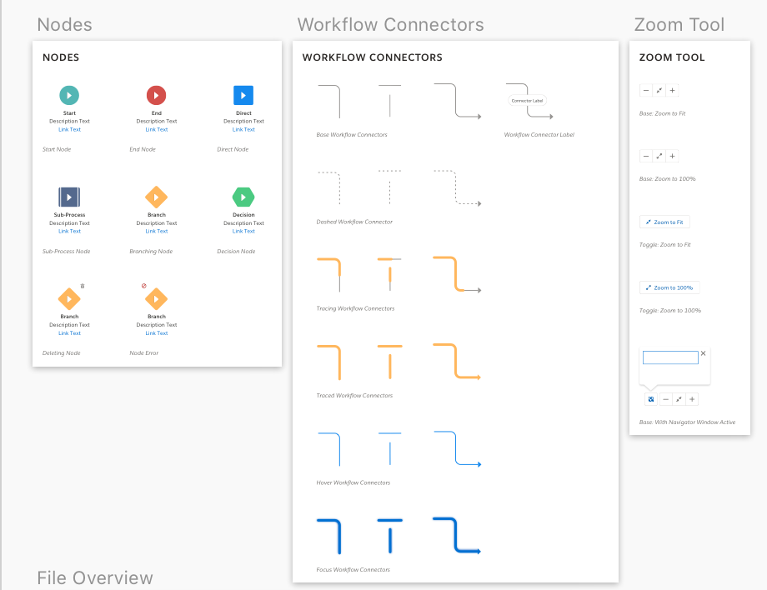
SLDS Pattern Builder
Notes:
Download Preview Files (PNG) - Download
Download Vector Files (SVG) - Download
Source files (templates and assets to build new pages) are accessible within the Sketch master file

Slide 12
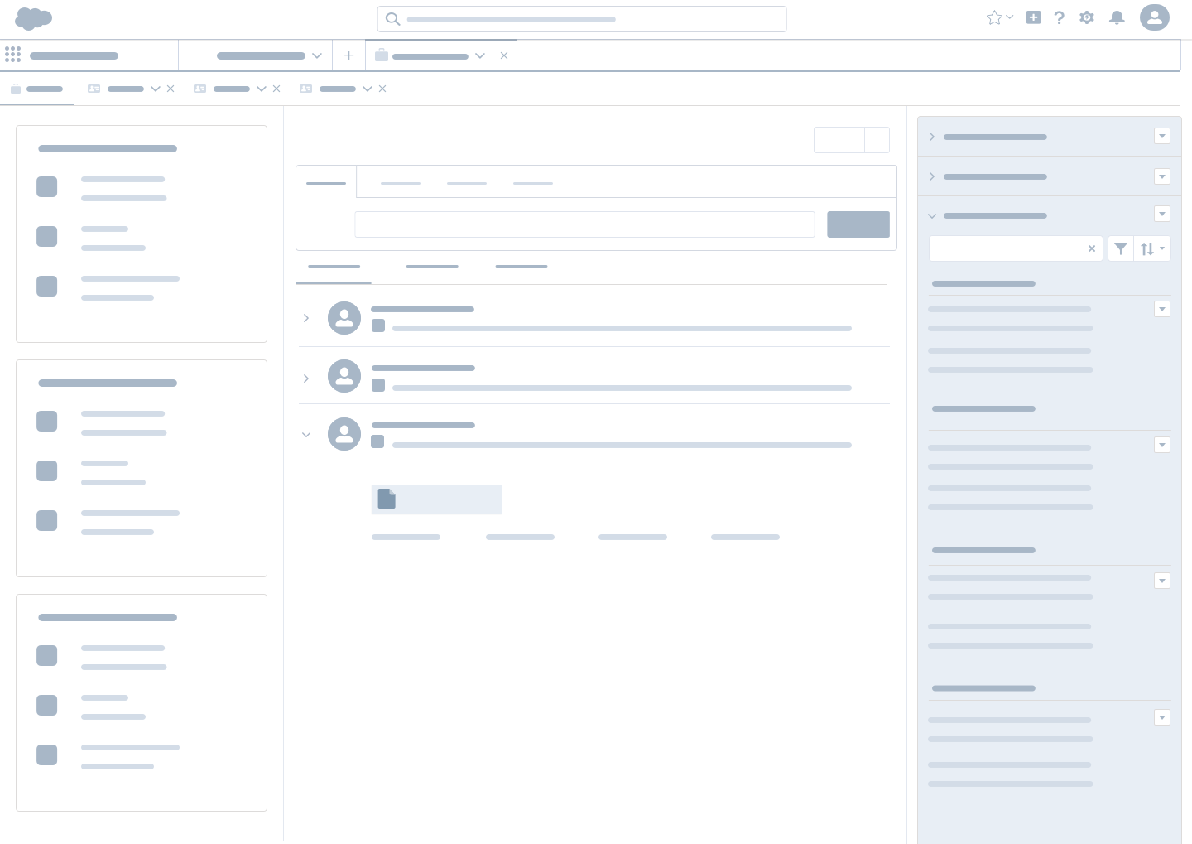
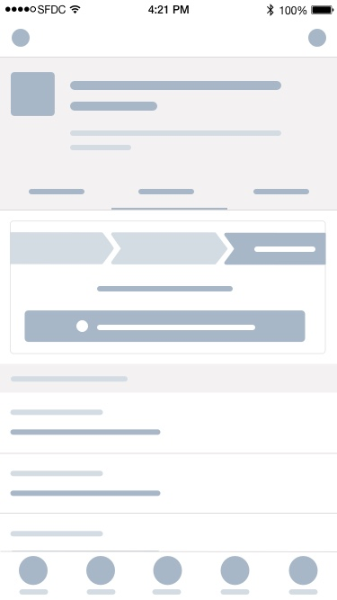
SLDS Wireframes
Notes:
Download Preview Files for Desktop - Download
Download Preview Files for Mobile - Download
Source files (templates and assets to build new pages) are accessible within the Sketch master file

Slide 13
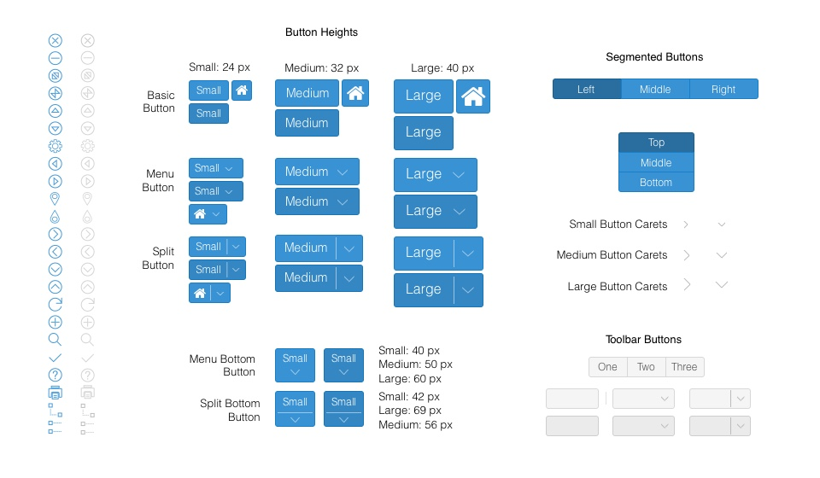
Sencha Component Gallery
*Work In Progress*
For our Sencha Components we use a custom theme called Iridium. There are not any EXACT Sketch assets available for our theme from Sencha. For mockups, illustrations, and prototyping the Crisp (classic) theme is the closest to our custom theme, and may be used for illustration purposes only.
UX and Development are currently creating a new Sencha theme to align with SLDS. When developing new pages or components using Sencha technologies, please consult UX and engineering for best practices.
Notes:
Download Component Preview files - Download
Note: Work in Progress - UX and Development are currently creating a new Sencha theme which will replace our current, custom theme - Iridium. This new theme will align with SLDS components.
Source files (templates and assets to build new pages) are accessible within the Sketch master file

Slide 14
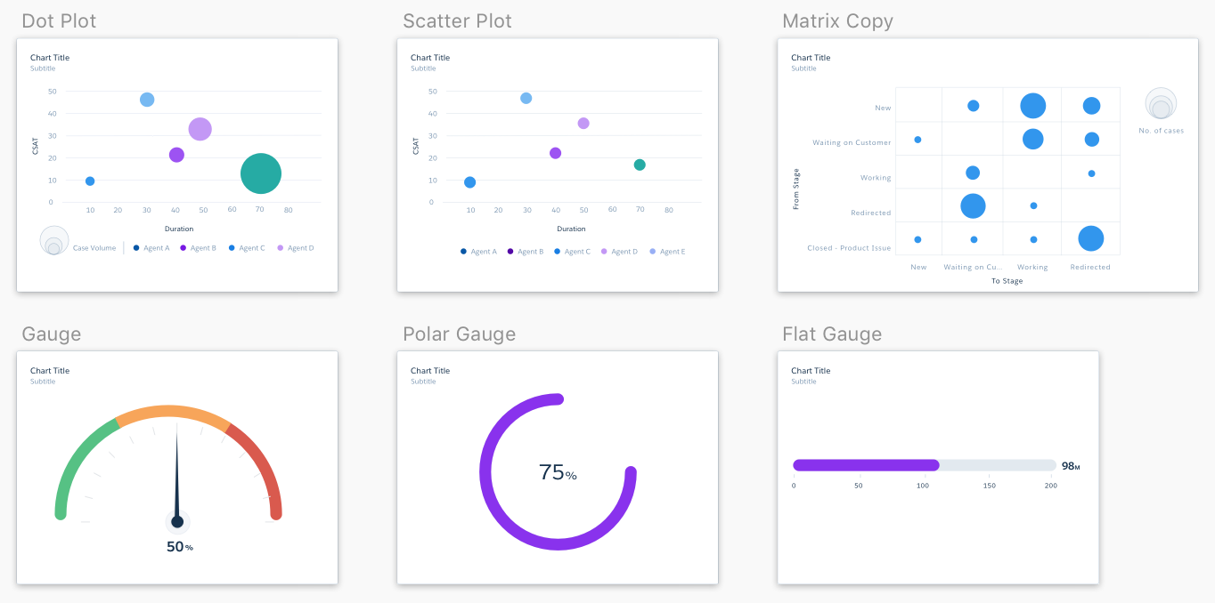
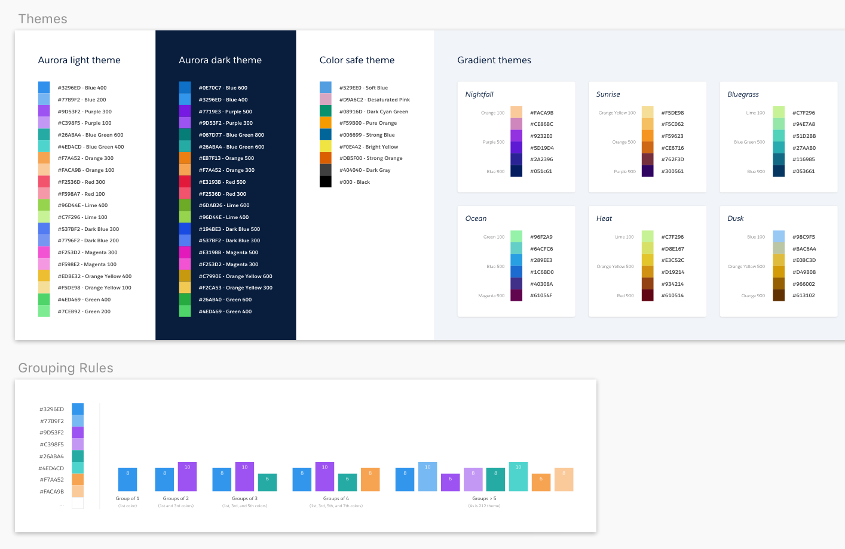
Einstein Component Library
See Einstein Resources for more UX
guidelines around Einstein
Notes:
Download Component Preview files - Download
Source files (templates and assets to build new pages) are accessible within the Sketch master file

Slide 15
Part 2
“Tools of the Trade”

Slide 16
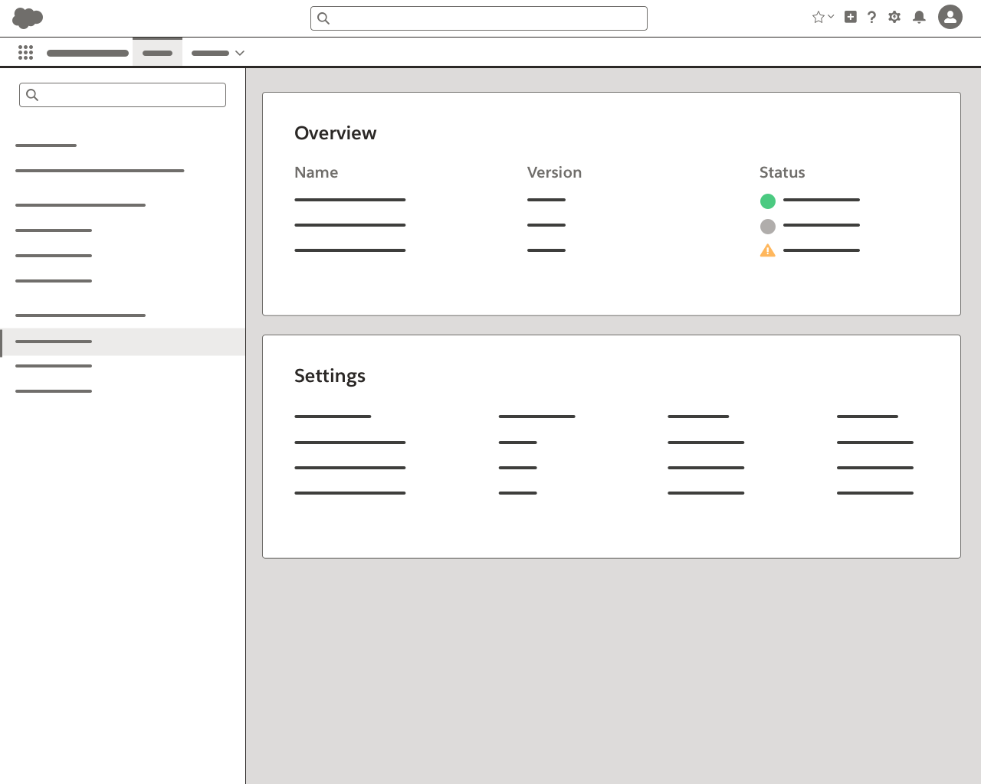
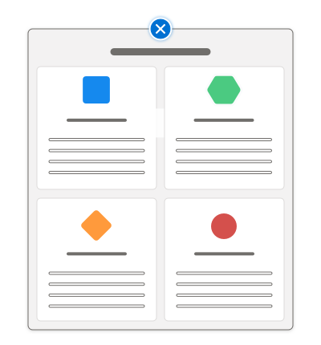
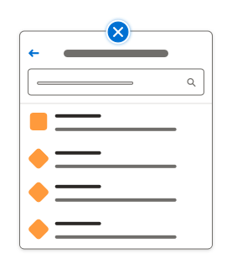
Wireframe Templates and Stencils
Quickly explore and discuss design options
Low fidelity UI stencils allows a designer to take a faster approach to rapid iteration before committing to higher fidelity designs.

Slide 17




Sketch
Design and Prototype
Sketch is our preferred tool of the trade. By using the same tool to design and prototype we can help to align our team’s design process amongst all of UX and our feature teams. Sketch allows us to have a consistent file type for easy communication and delivery of assets within our teams.
Sketch also allows us to create, maintain and update our design libraries while using a consistent grid pattern and page layout. With Sketch our UX teams can design, maintain, prototype, and sync with external tools like Abstract for versioning control and easily prototype using the Craft manager plugin with Invision.

Slide 18
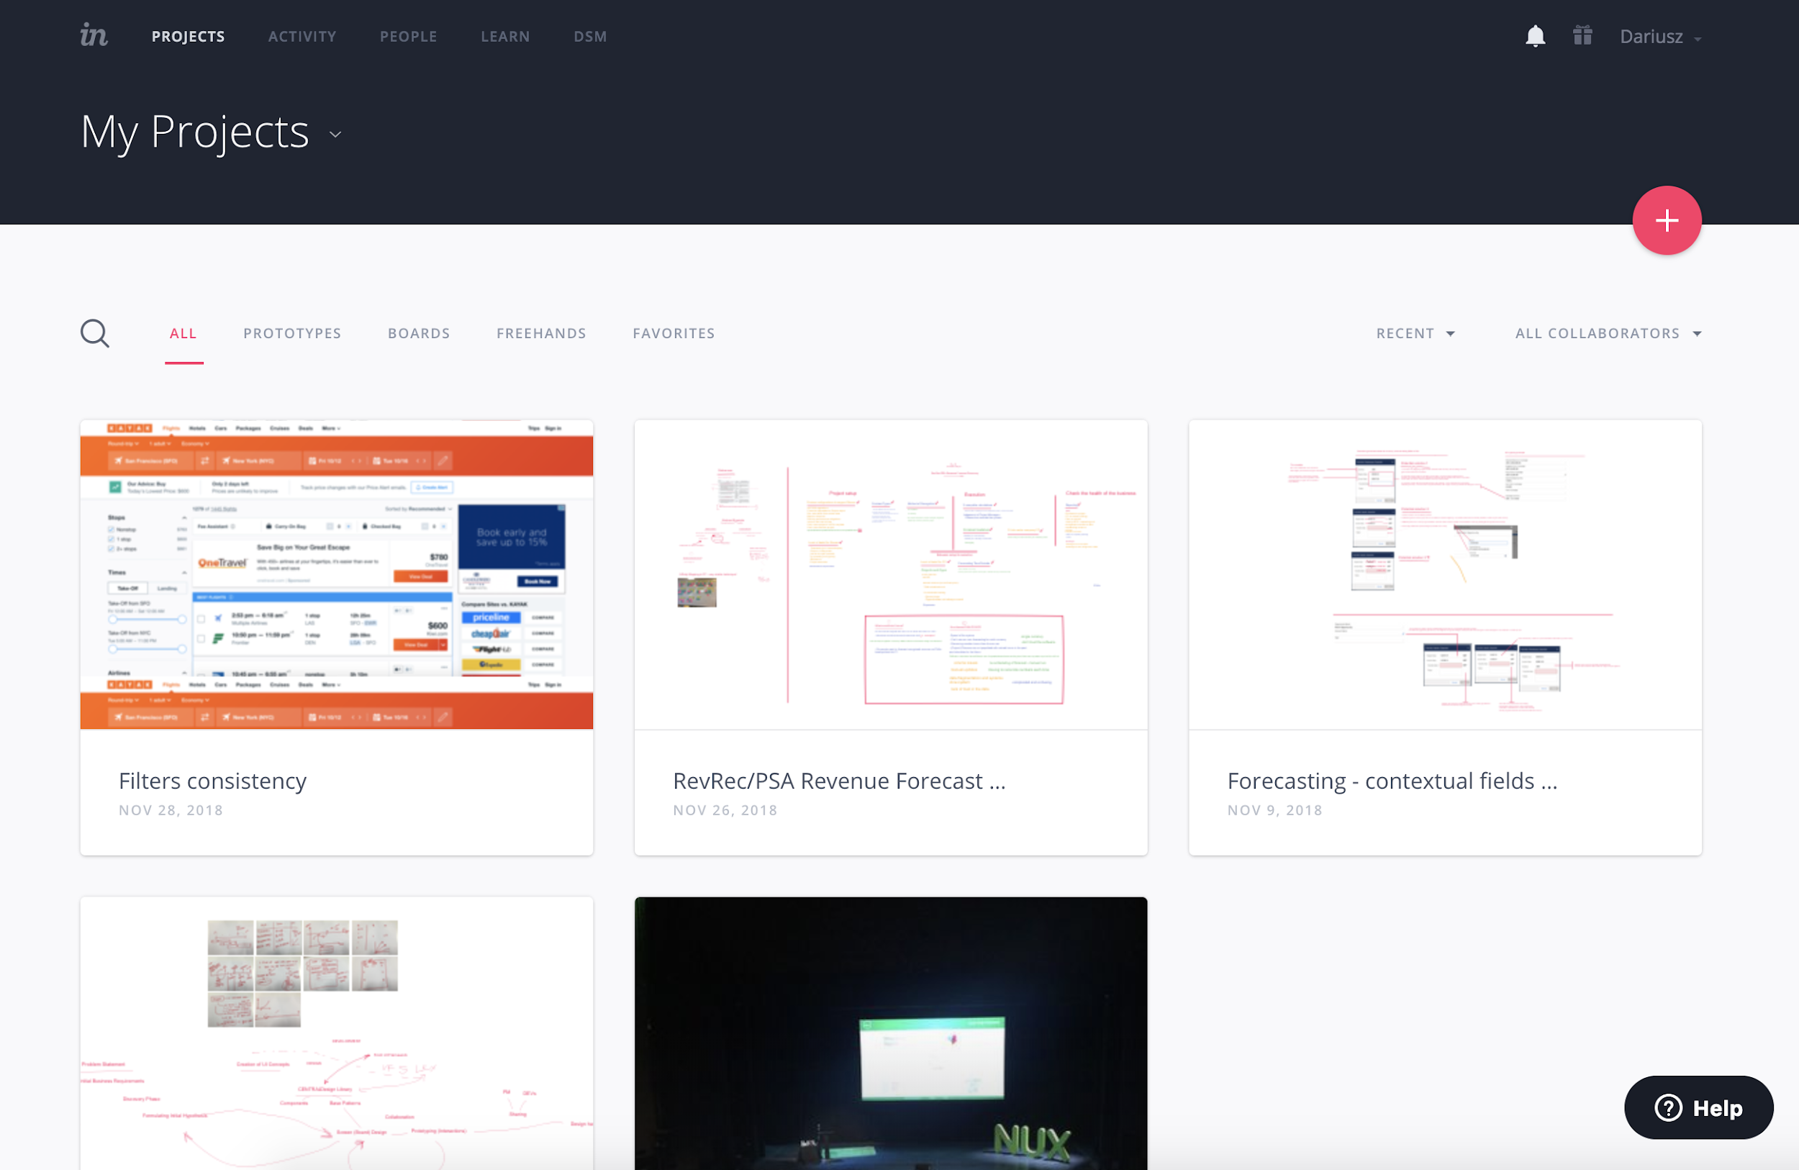
InVision + Craft Manager
There are a variety of ways to prototype using Sketch. One of the easiest is by using the Craft Manager App. Sketch allows you to easily prototype using the Craft Manager Plugin.
To download Craft Manager visit [link]
To Install the Plugin, unzip the folder and double click the application Icon to launch the installer.

Slide 19
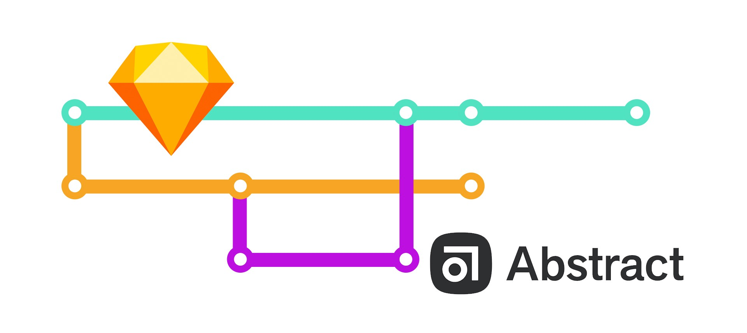
Abstract
Why versioning system?
Abstract enables designers to reliably version and manage their Sketch files.
By leveraging and extends the technology of git, Abstract provide design teams with a lightweight workflow and stable tools so designers can work together with confidence.

Slide 20
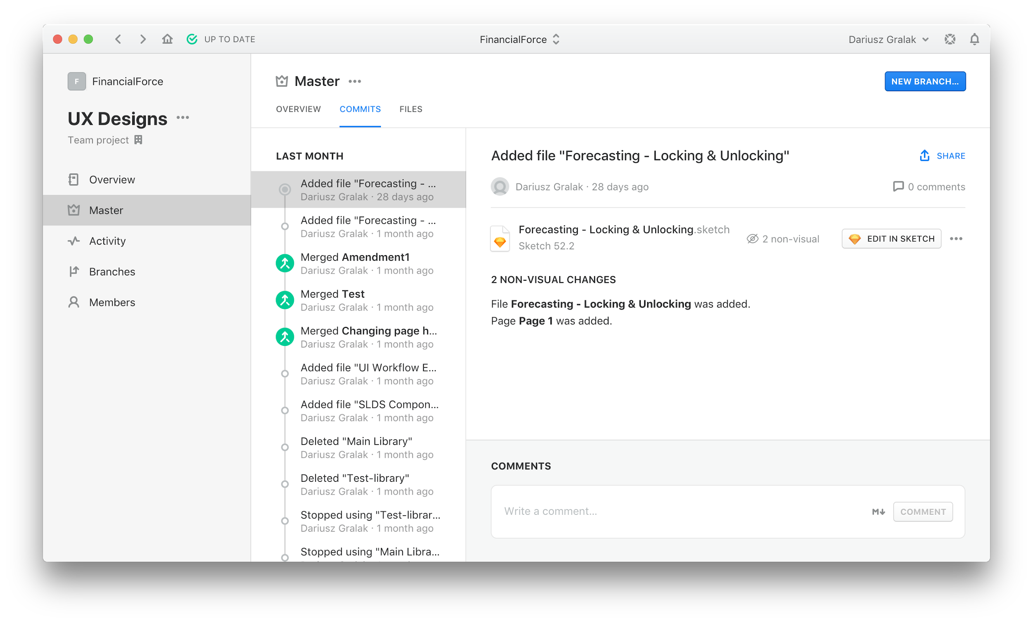
Abstract
The sketch files are grouped into Projects - where you have your Master sketch file - the one and only production version of your design and assets, as well as Branches that you create for some work-in-progress changes.
Each Branch can be discussed separately and has its status such as “Open for feedback”. When changes in a Branch are accepted, they are being Merged into a Master.
How versioning of design files works exactly?

Slide 21
Abstract Basic Workflow
Create a Project
Create a Branch
Commit changes in the Branch
Merge to Master
Create a Project and import readymade Sketch files or create a new one.
Create a Branch for changes in the Design.
Commit changes in the Branch. Discuss changes and iterate with more Commits or sub-branches..
When changes are accepted, Merge to Master.

Slide 22
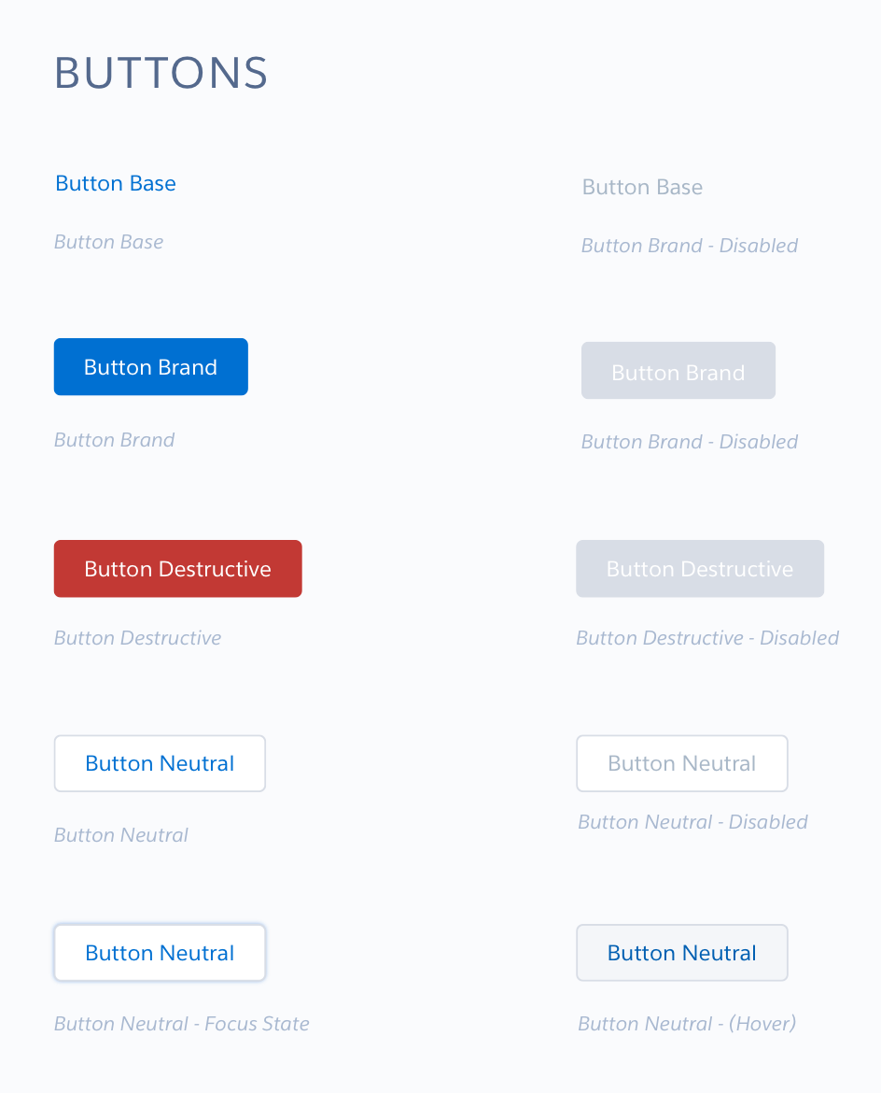
Abstract
Easier Sketch UI libraries propagation
Libraries are the best way to share symbols across Sketch files. Instead of having to have one massive file with everything in it, your team can now centralize shared design elements.
A source of truth for every symbol — no more duplicate or out-of-date Symbols
Organize Symbols into their own files
Allow your team to break apart monolithic design files, reducing overall file-size for better performance in Sketch and Abstract
Automatically update Symbols across files in a project
Use Abstract to track and commit changes made to those Symbols

Slide 23
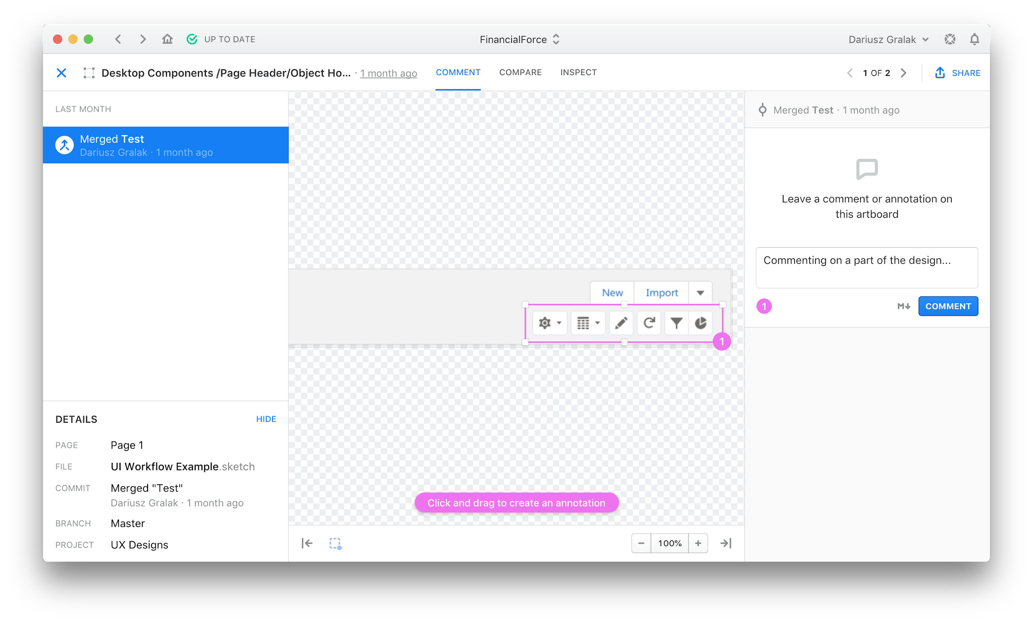
Abstract
Commenting and Annotating
made easy!
Give designers, engineers, and other stakeholders full access to view and comment on design work in progress.
It also allows to see easier what’s changed from one version of the design to the next, and why.

Slide 24
Abstract
Better collaboration
Abstract instills better collaboration because it allows designers to view teammates’ work in progress and explore new ideas from those ideas, without the fear of overwriting the original designer’s work.
Quicker onboarding
Gives the ability to onboard new team members faster by reviewing all past work history, decision-making, and commentary in a single location.

Slide 25
Part 3
Design Process

Slide 26
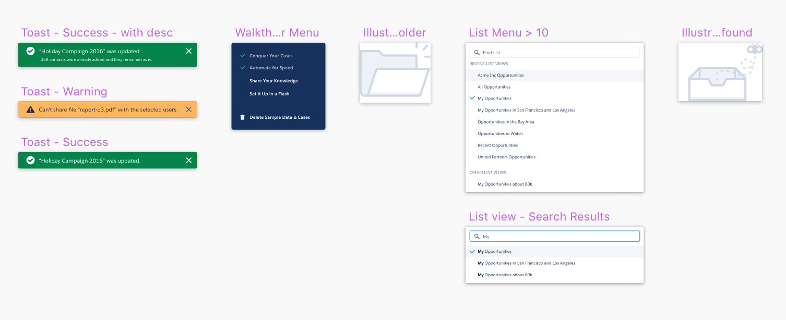
Creating Libraries
A Library is a set of Sketch Symbols which can be used across an entire project or design team. Using a Library, you can sync design assets such as icons, buttons, user interface elements, and more.
When the original Symbol is altered in the Library document, each instance of this Symbol will be updated simultaneously. This means you won’t have to go into each design file to make an update.

Slide 27
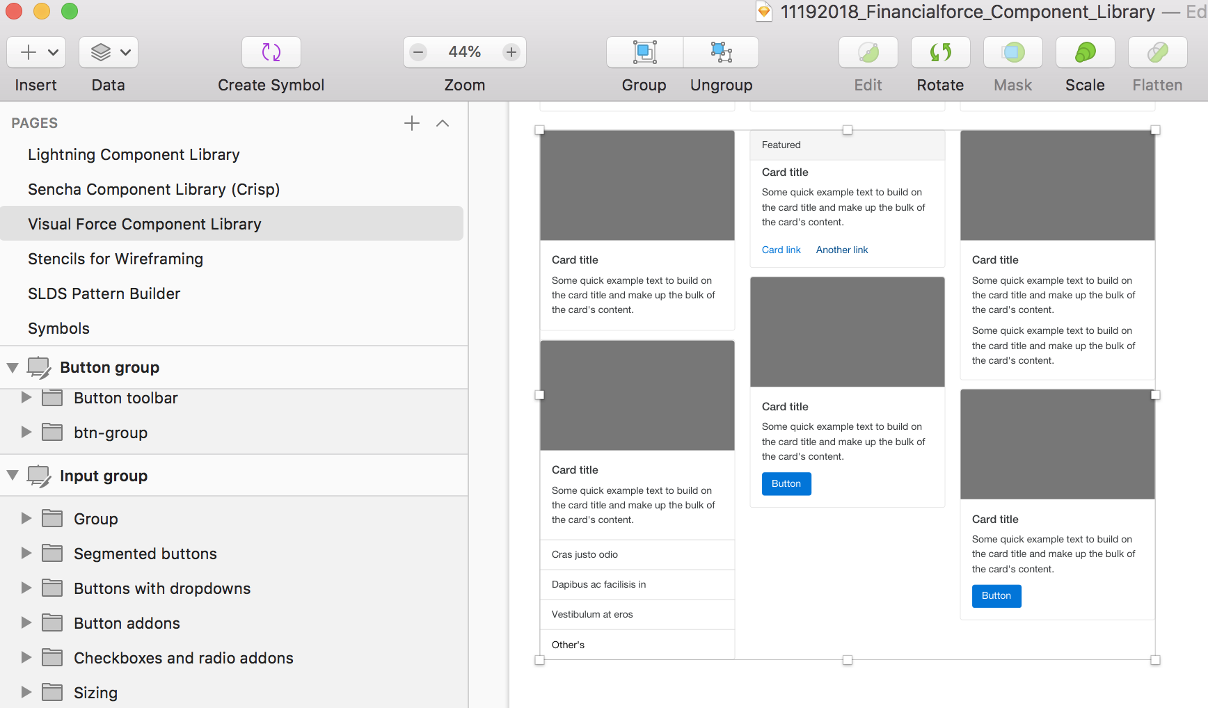
Creating Symbols
To create a symbol navigate to any design element on your artboard and click the Create Symbol button from the top left of your nav bar. This will turn the chosen asset into a reusable symbol.

Slide 28
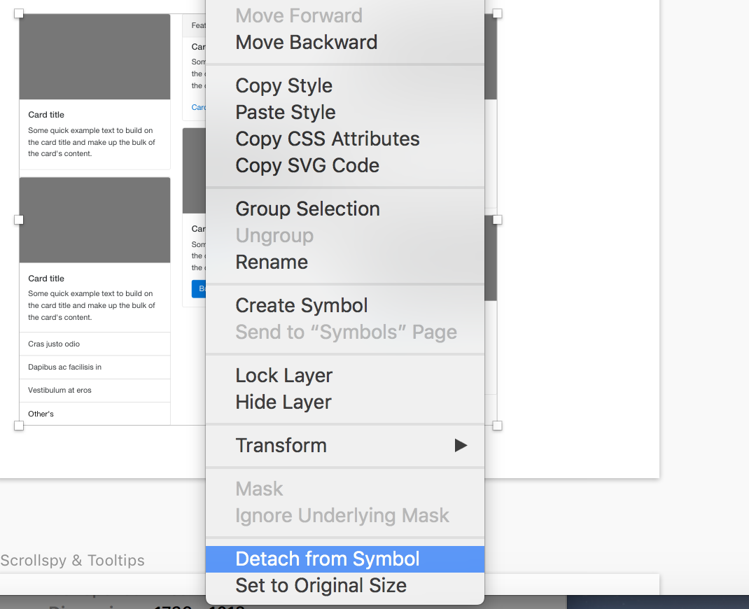
Editing Symbols
To edit a symbol, click on the desired symbol from your artboard and click Detach from Symbol This allows you to edit this item without overriding all of the instances of this symbol in your document. Detaching an item from your symbol library also allows you to create alternate versions of graphic elements without designing the same thing twice.

Slide 29
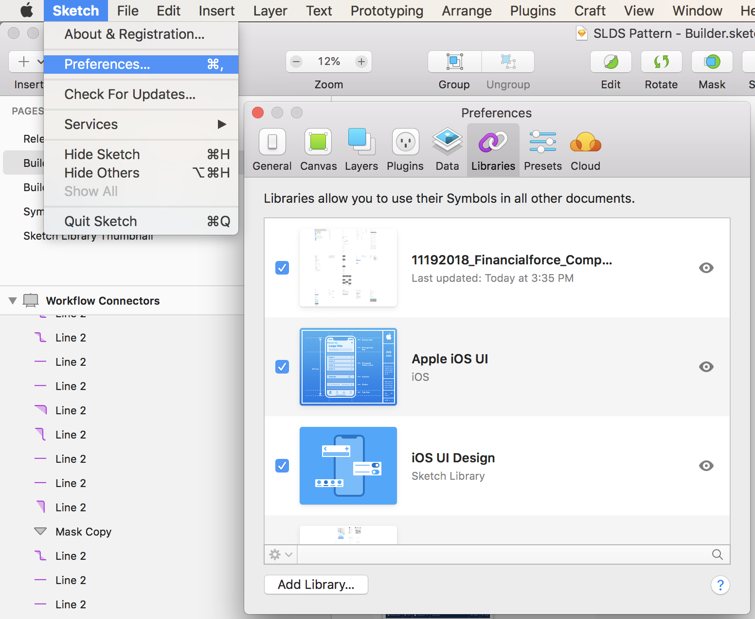
Sketch Libraries
To create a sketch library, click Sketch, then click Preferences and a modal window will appear. Navigate to the Preferences tab and you will see a list of libraries. If there are items listed you can edit or delete them.
You can also add a new library by clicking Add Library.

Slide 30
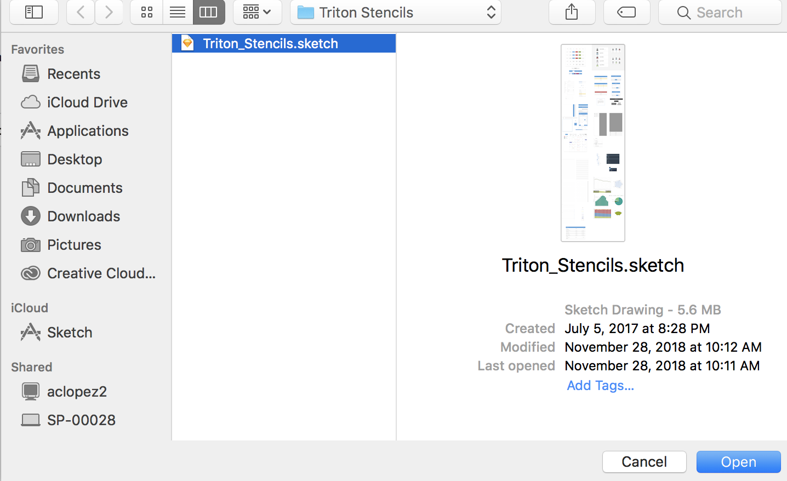
Sketch Libraries
Once you have clicked Add Library, navigate to any Sketch document you would like to reuse assets and symbols from and click Open.
This will add your Sketch file as a library item. Symbols you have created from this Sketch file will now appear in the symbols page of your design document.

Slide 31
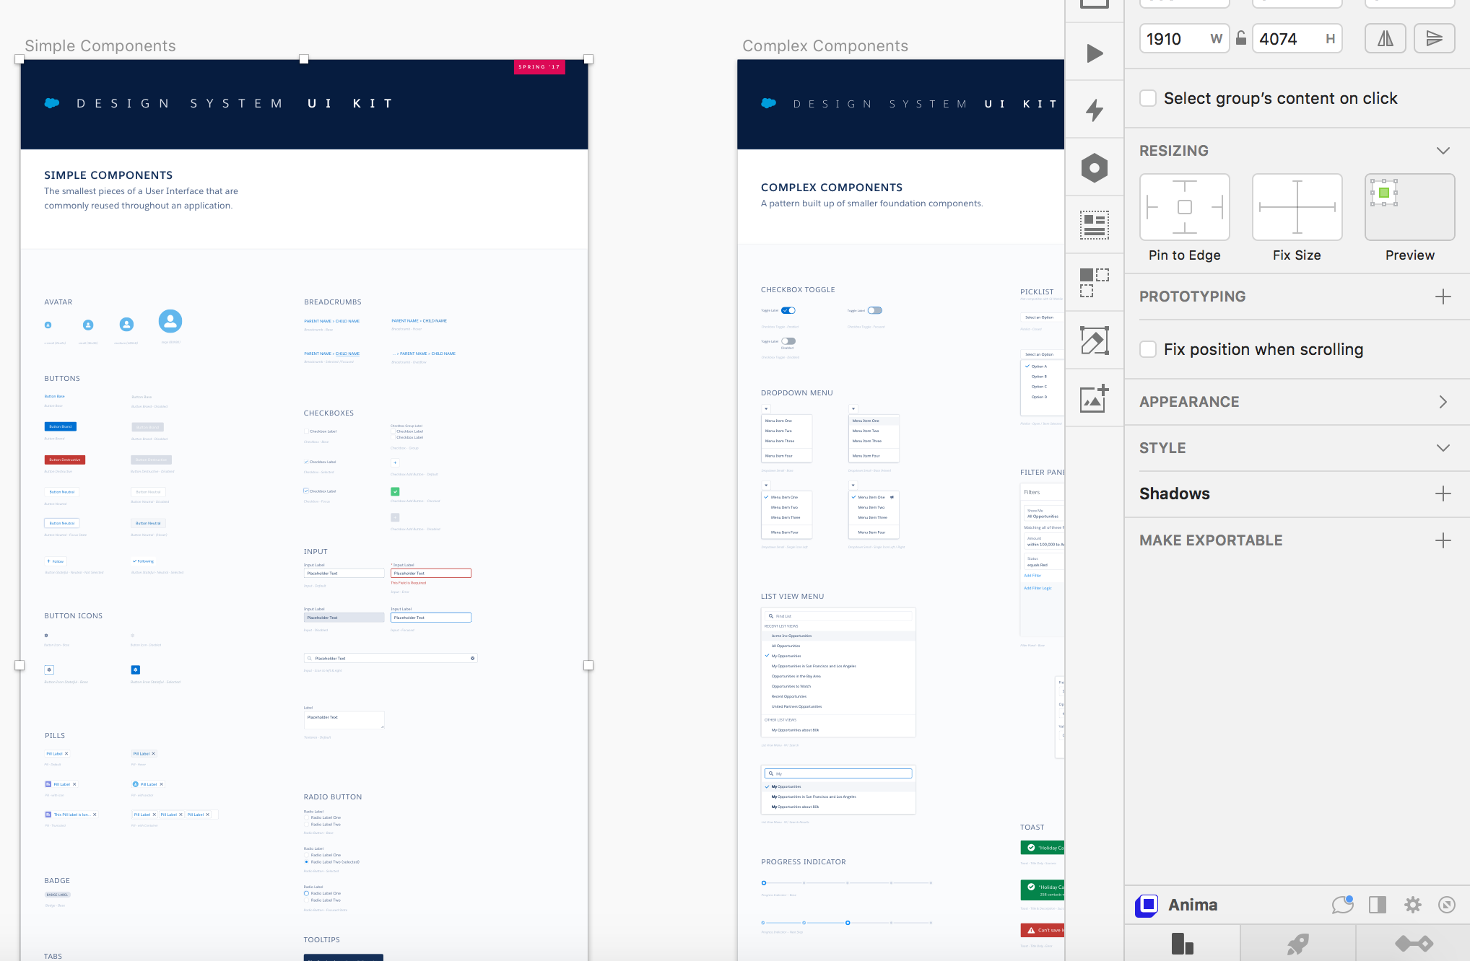
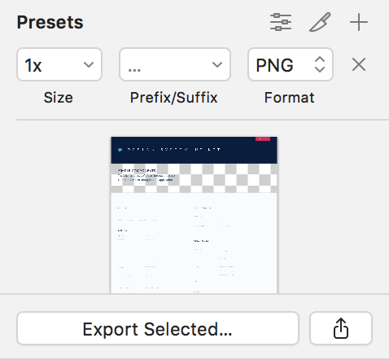
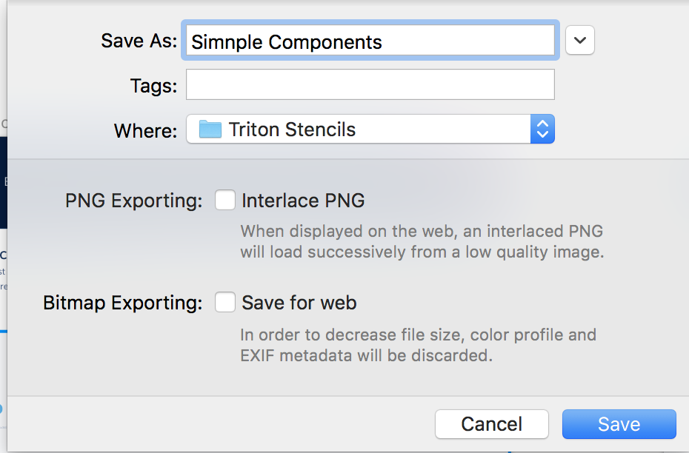
Exporting from Sketch
A great feature of Sketch is the power to create presets for asset export, this helps greatly with production and workflow amongst teams.. You can do this with graphics, icons, and pages.
1- To export an item, first select the desired graphic or artboard and click, Make Exportable.
2 - Select your desired size, file format and click Export Selected. 3 - Name your file, navigate to the desired location on your computer and Save.
1
2
3

Slide 32
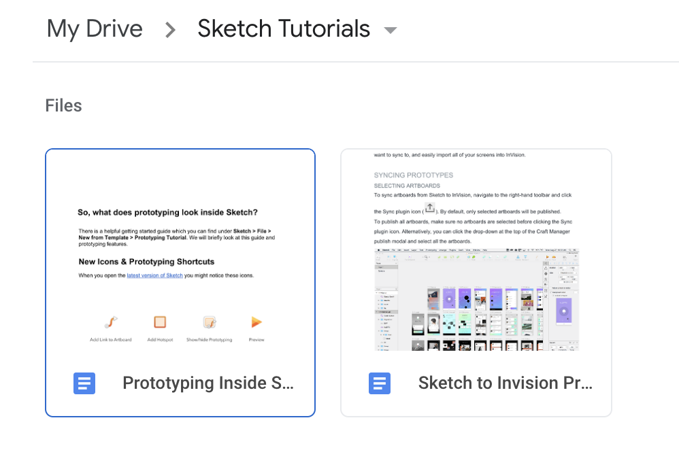
Prototyping in Sketch
There are a variety of ways to prototype using Sketch. One of the easiest is by using the Craft Manager App. Sketch allows you to easily prototype using the Craft Manager Plugin. You can also prototype directly in Sketch.
There are more in-depth tutorials on Google Drive.
See:
Prototyping Inside Sketch
Sketch to Invision Prototyping & Sync with Craft

Slide 33
Thank you!

